Slide 1
Getting an Automatic Dysarthric Speech Recognition System to work better for people with speech disorders
COM - MSc Dissertation (2019-20)
Name: Yanghao Zhou Email: yzhou132@sheffield.ac.uk MSc Program: CSSLP
Supervisor: Heidi Christensen

Slide 2
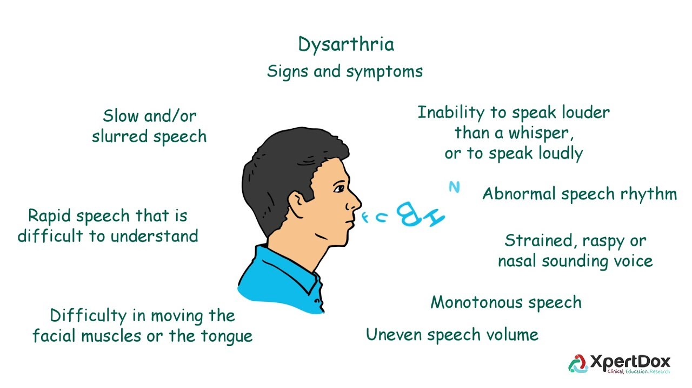
Introduction
What is Dysarthria？
Dysarthric speech + ASR = ADSR!
ASR tools may not work well on dysarthric speech
So we need to build ADSR system to help people with speech disorders!
What a beneficial and exciting area in Speech Technology!
General or Personalized?
Picture reference: https://www.youtube.com/watch?v=gD80xdT_uLE

Slide 3
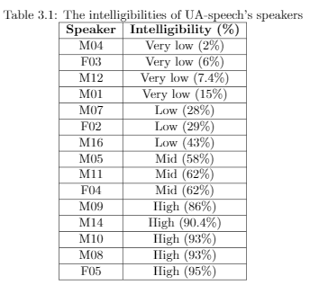
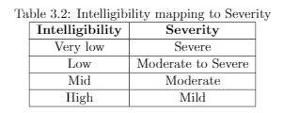
Methodology
Control = Typical speaker
DYS = Dysarthric speaker
What dataset we used and what tools we used:
UA-speech (13 CTL, 15 DYS) , Kaldi [1] Toolkit on ShARC
We had a baseline based on GMM-HMM model
and then explored new ideas to improve the ADSR system:
Better Data preparation
Speech Modification
Combining Feature with Pitch (F0)
Hybrid DNN-HMM.
Then evaluation on models with Word Error Rate (WER)

Slide 4
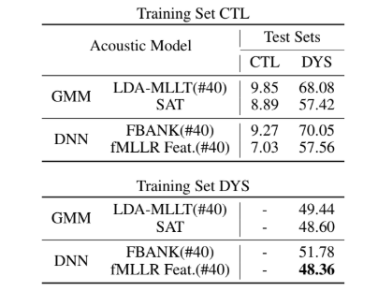
Baseline
Xiong’s Baseline:
Best WER of GMM-HMM: 48.60 %
Best WER of DNN-HMM: 48.36%
ref:https://github.com/ffxiong/uaspeech
We found that fMLLR feature could improve the performance of ADSR system.
Baseline results with traditional ASR setup for UA-Speech corpus.[2]

Slide 5
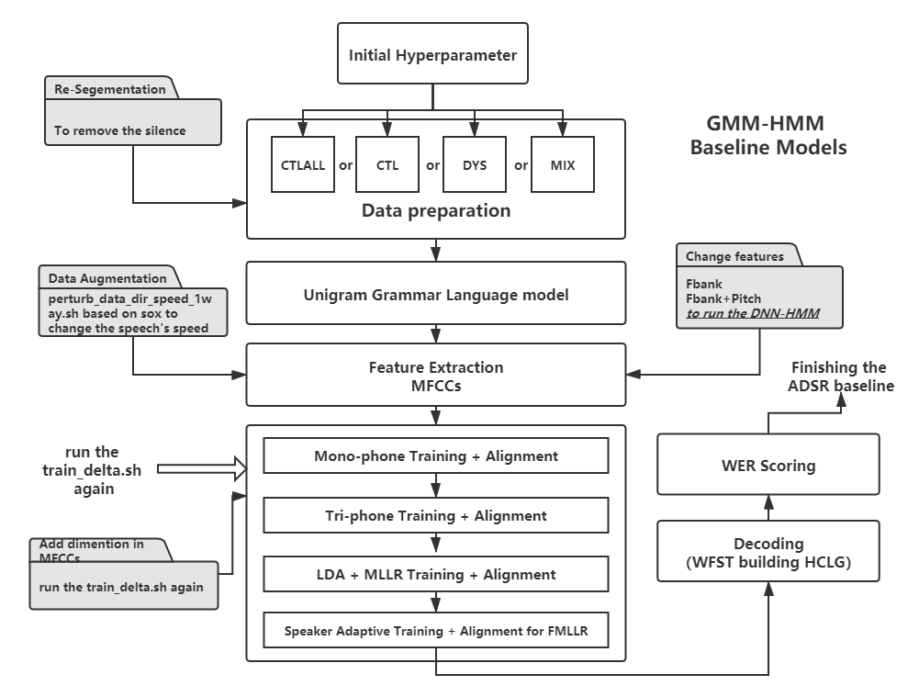
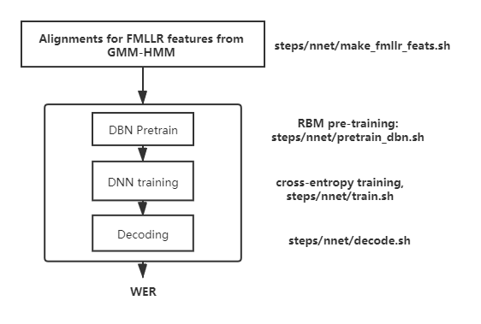
Design of the ADSR System

Slide 6
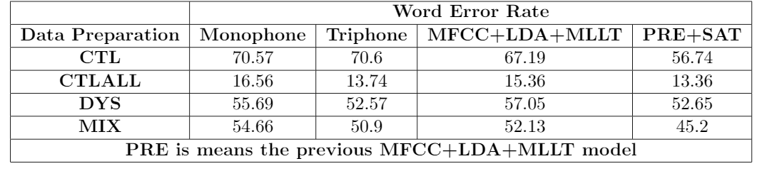
Data preparation in baseline
CTLALL: Both training(B1 and B3) and test sets(B2) are Control data
CTL: The training set is control data(all), but the test set uses dysarthric speech data(B2)
DYS: Both the training and test sets are dysarthric speech data, and B1 and B3 are train set, B2 is test set.
MIX: A training set with a mix of control data(all) and dysarthric speech data(B1, B3) and the testing set just uses dysarthric speech data(B2) M
MIX Style data preparation + LDA+MLLT+SAT could generate the Best Result

Slide 7
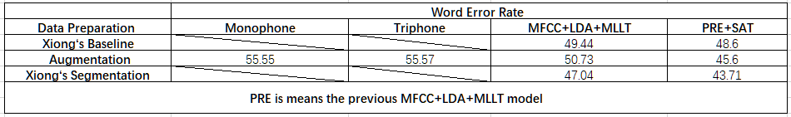
Data Augmentation / Speech Segmentation
Augmentation: Changing the speed of speech file
Segmentation: removing the silence of speech file replace the mlf files to mlf(segment already)
1.0 speed -> 1.1 speed
Based on GMM-HMM Model
Speech augmentation and Re-segmentation could make a significant improvement in GMM-HMM

Slide 8
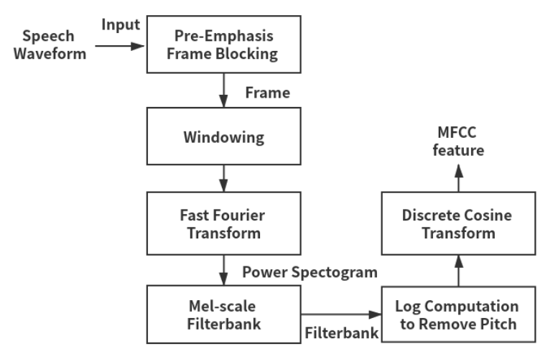
Feature Extraction
General feature: MFCCs
Filter Bank
UAspeech: Spastic dysarthria
In this case, a low pitch with pitch breaks often occurs.
Pitch features have long known to be useful for ASR
Pitch was removed
Our idea in dissertation for dysarthric speech recognition:
Using the Features with 3 dimentional Pitch

Slide 9
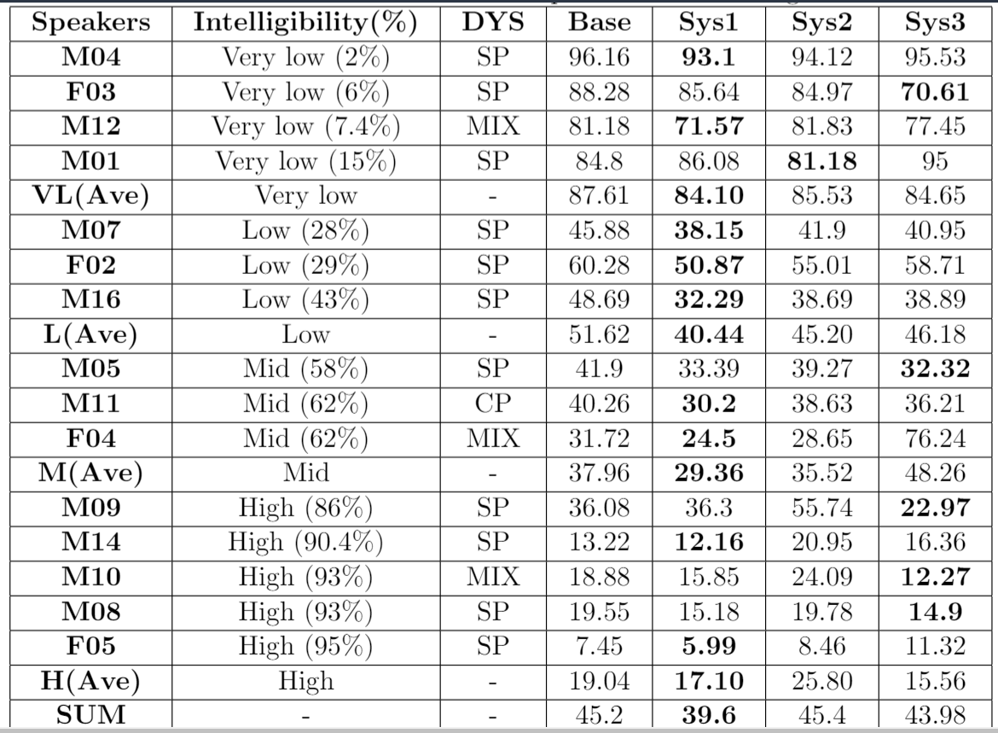
Results for different Features
DYS Column: Dysarthric Symptoms
SP: Spastic Symptom
CP: Cerebral Palsy Symptom
MIX: Mixed with above two symptoms
Base: Baseline system based MFCCs
(GMM-HMM with MIX style)
Sys1: DNN-HMM with MIX style
Based on MFCCs
Sys2: DNN-HMM with MIX style
Based on Filter Bank
Sys3: DNN-HMM with MIX style
Based on Filter Bank with 3d Pitch
The best result is Sys1!

Slide 10
Conclusion
Good organization on data preparation can reduce the WER.
Reducing the speed of speech and removing the silence both can reduce the WER.
Feature+Pitch can work better on most moderate and mild dysarthric speech in DNN.
MFCCs can reduce the overall speaker’s WER in DNN.
We built a better ADSR system compared to previous research.
However, the dysarthric speech with severe is still hard to recognize.

Slide 11
Further Work
Exploring the SD and SI based on Fbank+Pitch and MFCCs+Pitch
Combining the segmentation and augmentation with Fbank+Pitch or MFCCs in DNN-HMM
Tring different models like GCN or different augmentation method like volume perturb.
Tring the LF-MMI in the UA-speech
Training the Torgo by the different language model

Slide 12
Reference
[1] D. Povey, A. Ghoshal, G. Boulianne, L. Burget, O. Glembek, N. Goel, M. Hannemann,
P. Motlicek, Y. Qian, P. Schwarz et al. , “The kaldi speech recognition toolkit,” in IEEE 2011 workshop on automatic speech recognition and understanding, no. CONF. IEEE Signal Processing Society, 2011.
[2] F. Xiong, J. Barker, and H. Christensen, “Deep learning of articulatory-based representations and applications for improving dysarthric speech recognition,” in Speech Communication; 13th ITG-Symposium. VDE, 2018, pp. 1–5.

Slide 13
Question & Answer
Thank you so much！
I would like to express my gratitude to all of my supervisors and teachers in the University of Sheffield. Thanks for their support and help, understanding and kindness.

